Slide 1
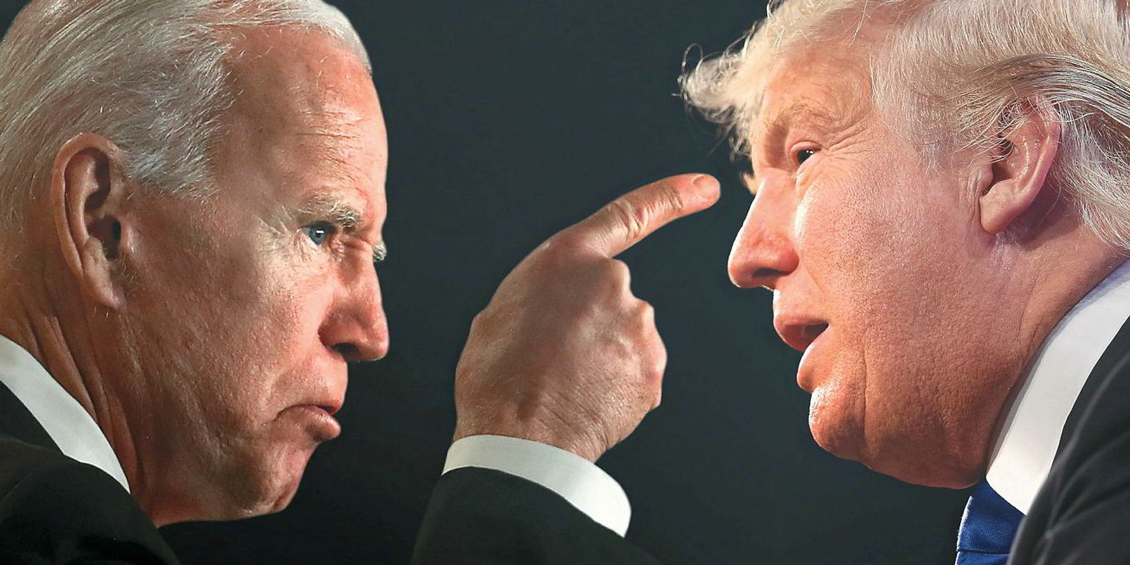
TEP4221
Jonathan Dysvik and Christoffer Røneid

Slide 2



Research question
What is the relation between state partisanship in the US and the corresponding state’s energy investment?
Notes:
Snakker om Research question
Hvorfor det er relevant til sustainable development goals
why USA, USA is the country with the highest gdp in the world, and are sentral in
Democrats are more than three times as likely as Republicans to say dealing with climate change should be a top priority (78% vs. 21%). - Pew Research center
We are researching this to see if it actually is the case

Slide 3
Datasets
Raw
Population estimates of the United states as of July 1. from the United States Census Bereu - https://www.census.gov/data/tables/time-series/demo/popest/2020s-state-total.html#par_textimage_1574439295
The US Departments of Agriculture's data of energy investment of each state - https://www.wctsservices.usda.gov/energy/maps/investment, https://www.wctsservices.usda.gov/Energy/Downloads
Cartographic boundaries of the States from the Census Bureau in the form of a geoJSON file - https://www.census.gov/geographies/mapping-files/time-series/geo/carto-boundary-file.html
Auxiliary
The current state & legislative partisanship in the USA from the National Conference of State Legislatures - https://www.ncsl.org/research/about-state-legislatures/partisan-composition.aspx
Notes:
-måtte fylle inn manuelt, siden dataen bare var tilgjengelig som pdf

Slide 4
Challenges
Outliers
North Dakota
Visualization
State partisanship file

Slide 5
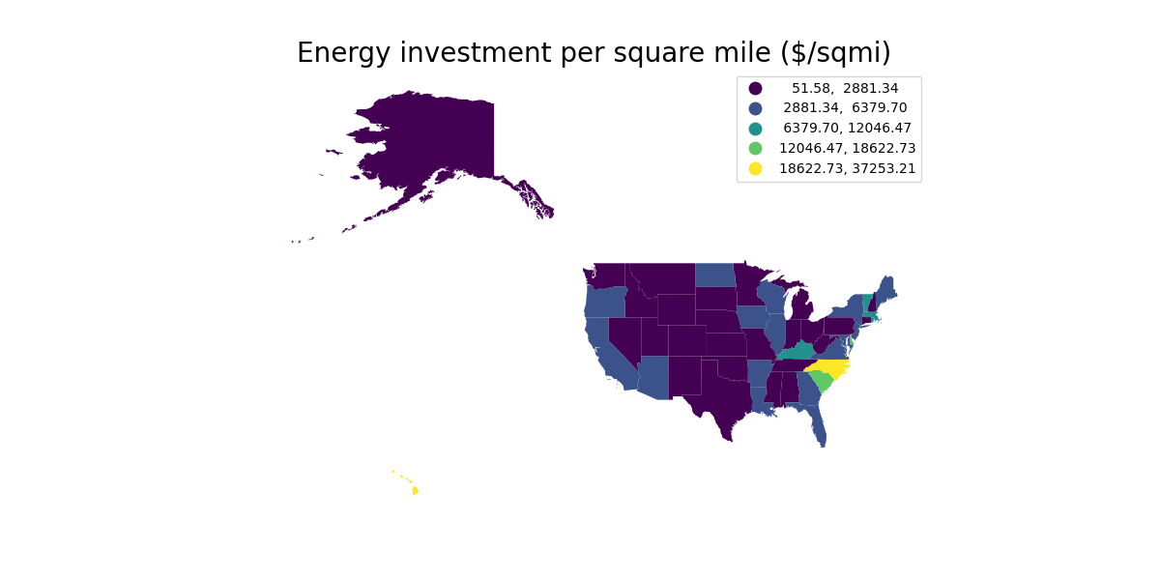
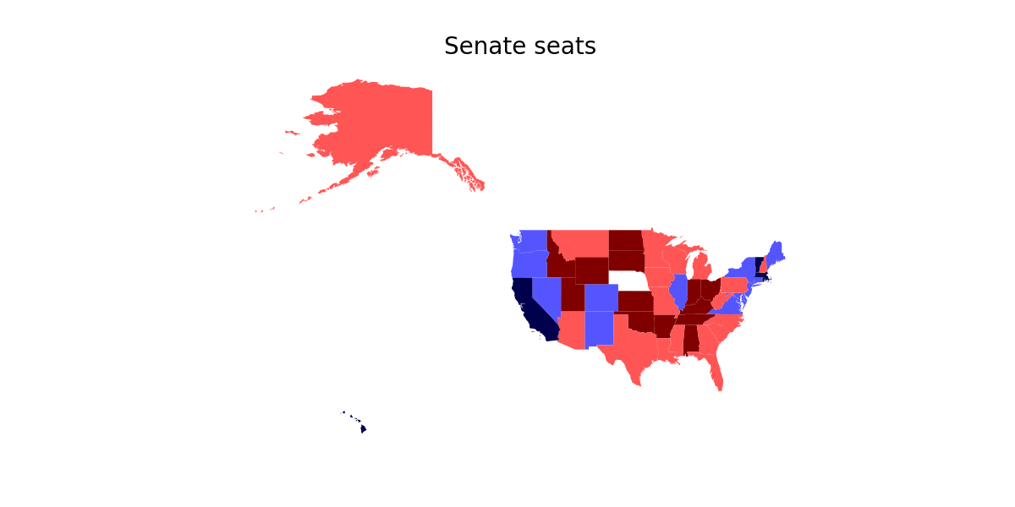
Plots part 1

Slide 6
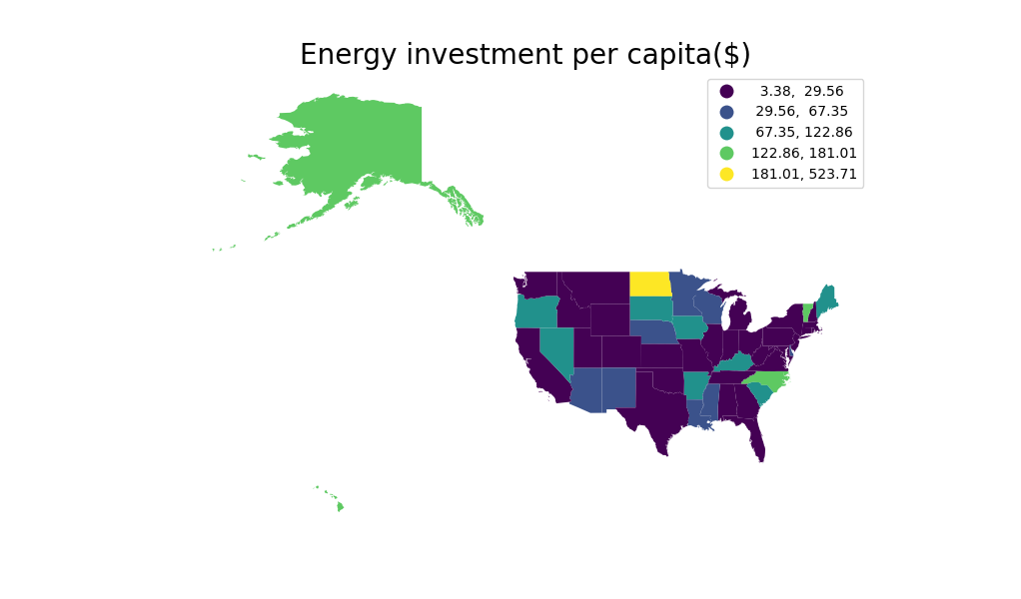
Plots part 2

